Slide 1
Assignment 3
Corey Horsburgh AU 3487170

Slide 2
Project Overview
This assignment is an extension of the HTML game from A2
Simple score-based game
Uses the keyboard for main gameplay, mouse for menus

Slide 3
Original Concept
Original idea for the game was a linear RPG similar to the Legend of Zelda games. Game was a top-down, action-adventure RPG.
Had linear progression, leveling, EXP, consumable items, money, shops, bosses and unique areas.
Realized that this was overly ambitious so scaled back to a simpler game focused on the combat.

Slide 4
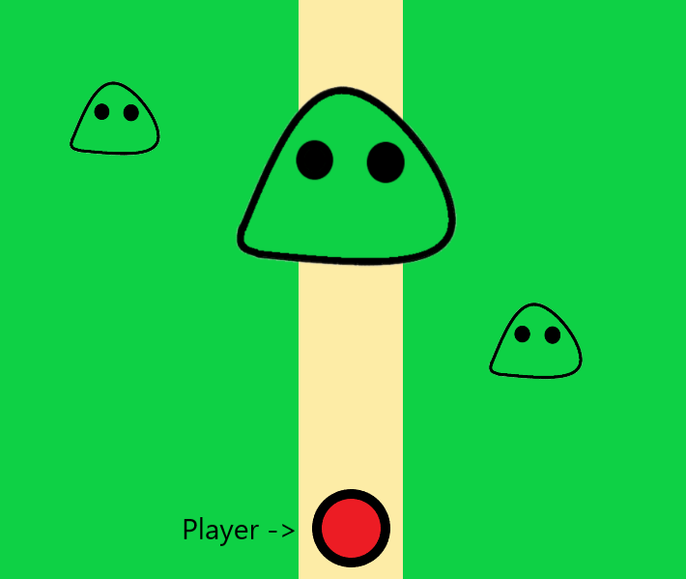
Sample area from original concept

Slide 5
Reworked Concept
The reworked concept kept the top-down perspective and basic combat but scaled things back significantly.
Only a few types of enemies were kept, and the RPG elements were dropped. Multiple playable characters with different stats were added to make up for it and improve replayability.
Game became an arcade style score attack game.

Slide 6
Core design of A2
Gameplay of A2 was very straightforward. Players moved around with the arrow keys and could hold space to attack. Touching an enemy while attacking did damage to them.
Killing enemies would score points for the player. Items would also spawn that could benefit the player such as damage or point multipliers. These were collected by simply touching them.
Players had 60 seconds to score as many points as possible. Enemies and items spawned at set intervals and orders.

Slide 7
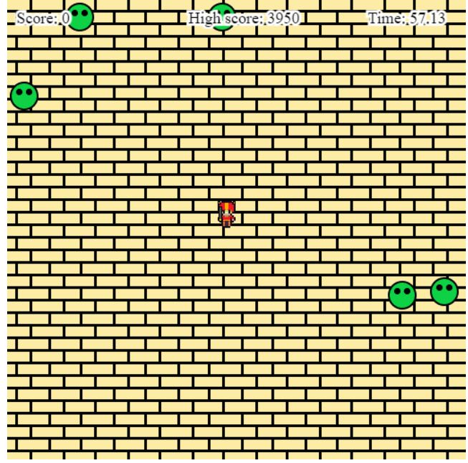
Screenshot of A2

Slide 8
Improving for A3
For assignment 3 the core idea and gameplay of A2 was kept and improved in a number of ways.
More options were given to the player for how they played including more maps and time limits for the game. Each map besides the first has unique hazards and enemies that only appear on them.
Many other improvements were made including changing how attacks worked and adding animation, improving the UI, sound was added, a pause button during gameplay, new items and improved item functionality. Enemy spawning behavior was also made more random to make things less predictable.

Slide 9
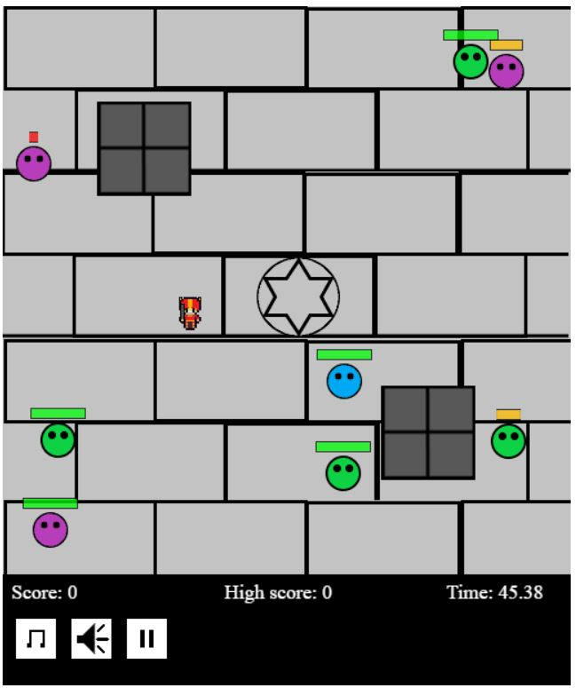
Screenshot of A3

Slide 10
Possible Improvements for the Future
While I am overall very satisfied with how A3 turned out, one thing I was unable to do that I had wanted was to implement a database to store high scores in a permanent fashion. While I have worked with databases in web development before, I was unable to figure out a way to get the high score values from the JavaScript file that ran the game to be added into the database. So, this functionality was ultimately scrapped for A3, though some remnants are still in the code as comments in case of future attempts.

